Slide 1
Transportation Technical Working Group
March 28th, 2024

Slide 2
Agenda
Trails
COMPASS
Bridges and Airports
MIRE data standards
Railroad and Freight Data

Slide 3
Trails - Alex Ernst -
Approval from IGC-EC
Updating Schema

Slide 4
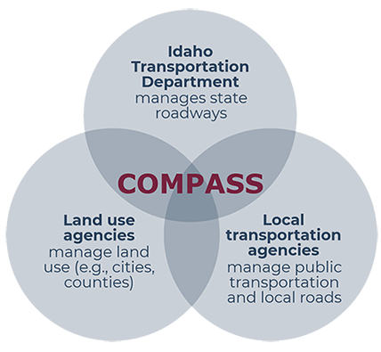
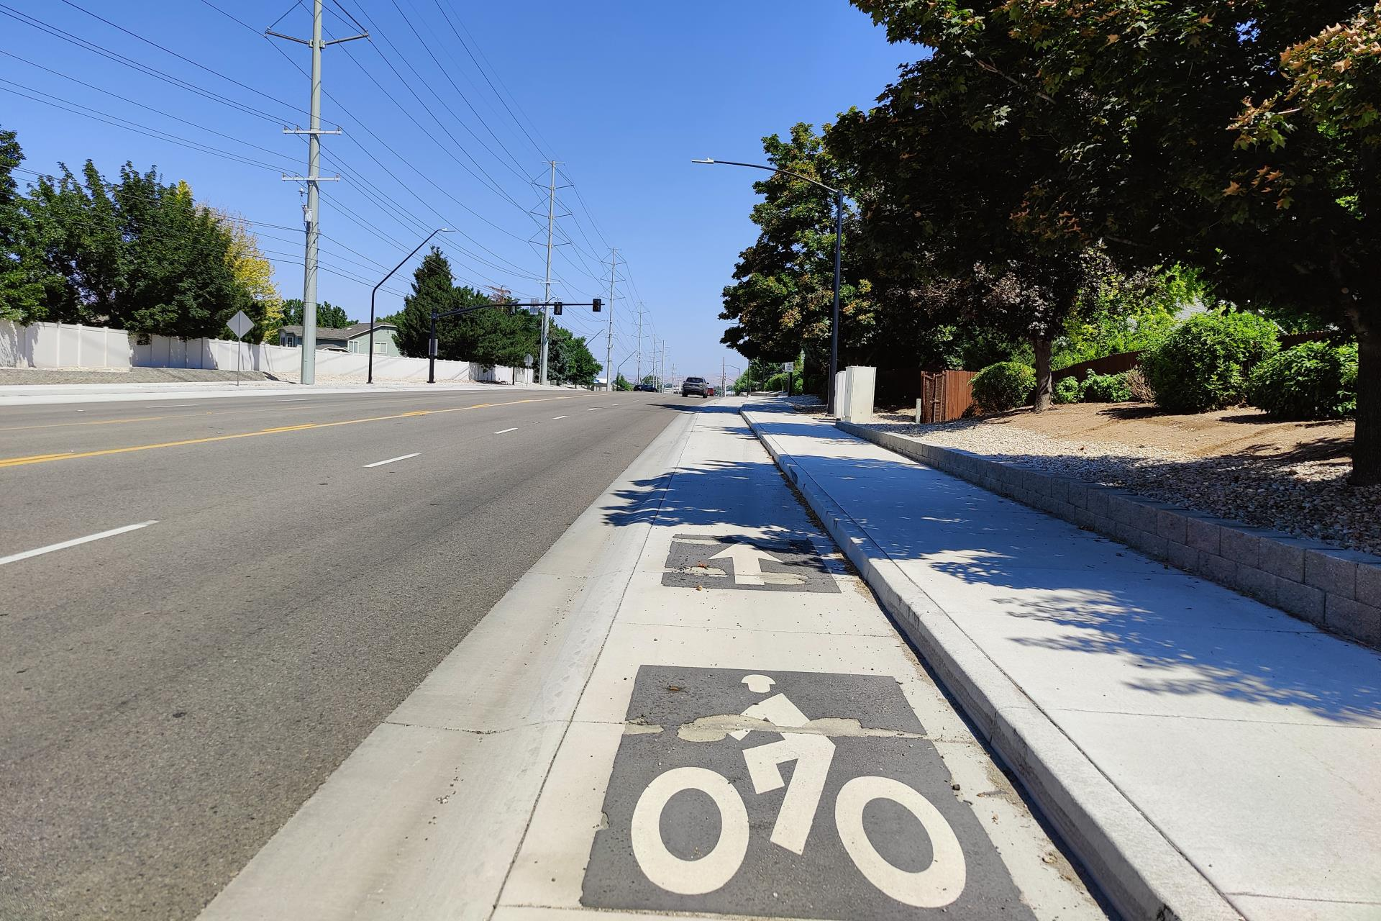
COMPASS

Slide 5
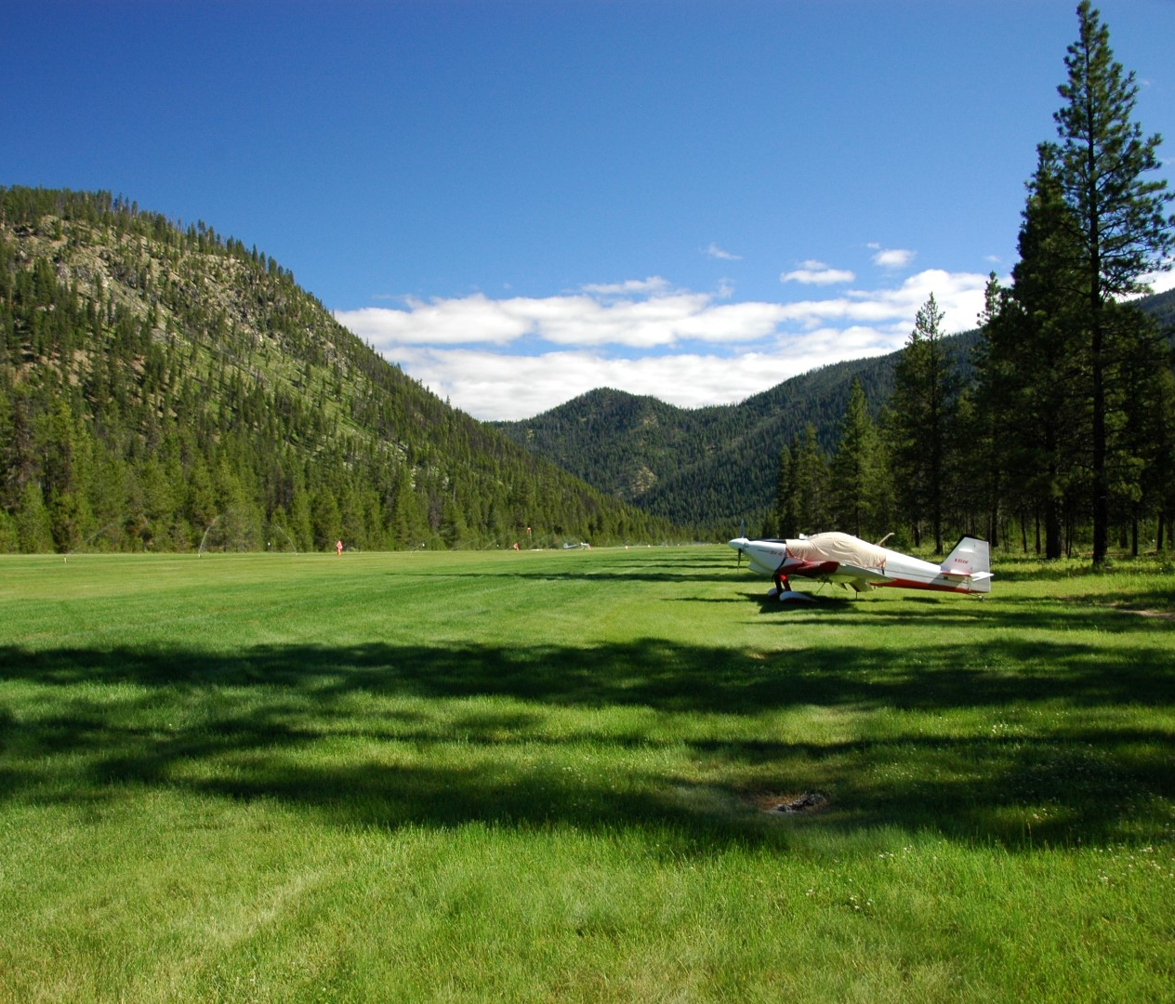
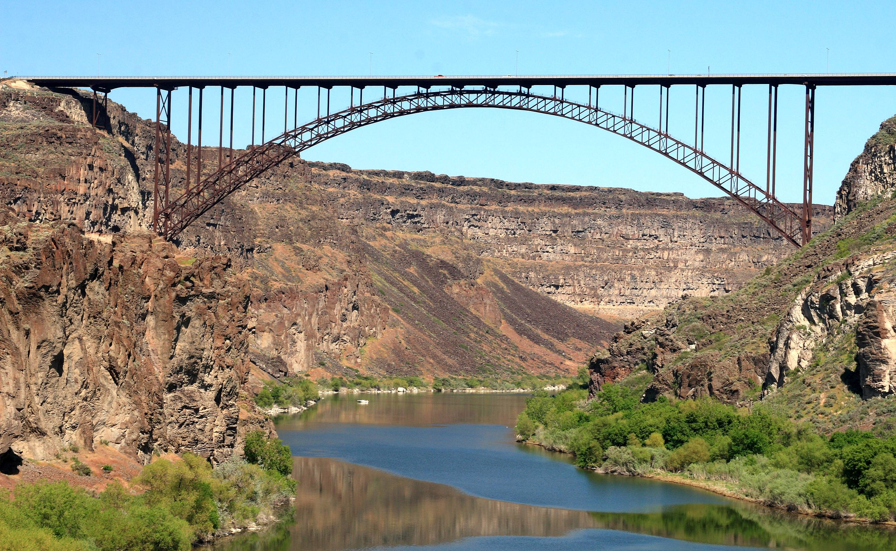
Bridge and Airports
Approval at next IGC-EC Meeting
Documentation Complete

Slide 6
MIRE Data Standards - Will Thoman -

Slide 7
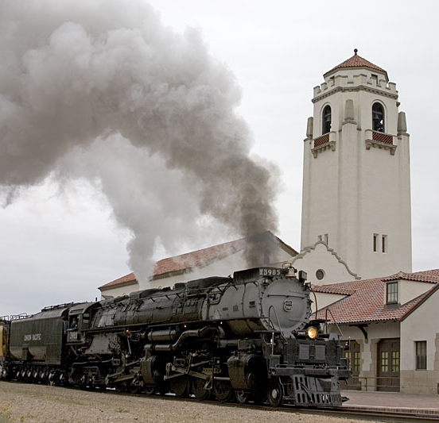
Railroad Data - Blaine Schwendiman-

Slide 8
Freight Data - Caleb Forrey-

Slide 9
Next Meeting
May 2nd 2024
10:00 am to 11:00 am MST

Slide 10
QUESTIONS?? Contact Information: Sydney.Lewis@itd.idaho.gov

