Slide 1
Climate TWG Kickoff
Welcome!

Slide 2
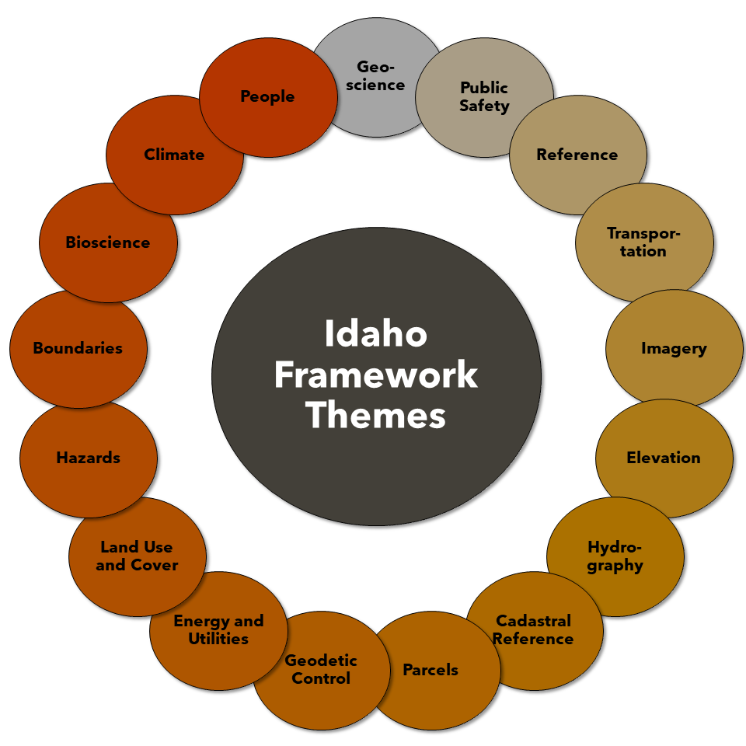
What is a Technical Working Group (TWG)
Identify, define, create standards and nominate datasets for The Idaho Map
Focus on statewide data
Any GIS user is welcome and encouraged to participate!

Slide 3
The Idaho Map (TIM)
About TIM
TIM Demonstration
Currently in Beta
Tentative release in early December

Slide 4
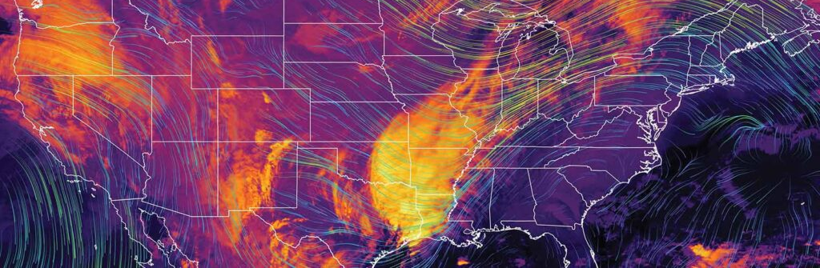
Climate
Historic Datasets (precipitation, temperature, snowfall, wind)
Potential overlap with Human Interest – Climate layers that affect people

Slide 5
Topic Suggestion
https://www.menti.com/al3k7h1rjp6v
mentimeter.com then use the code 3659259

Slide 6
Action Items
Interactive form within 1 week
Authoritative sources for identified historic datasets
Vote on order of top 3 datasets to start with
Leadership
I will be involved and working no matter what
Having external leadership works better and keeps things moving
Meeting Frequency / Next Meeting Date
Monthly at a minimum, with contact and interactivity in between
Next Meeting:

Slide 7
Open Floor
Comments, questions, jokes, suggestions?

Slide 8
Thank You!
Contact: Bradley Bean – bradley.bean@its.idaho.gov

