Slide 1
Transportation Technical Working Group
March 28th, 2024

Slide 2
Agenda
Nominating Trails
Data Standards (Bridges and Airports)
Railroad and Freight Data
MIRE data standards

Slide 3
Nominating Trails - Alex Ernst -
Send out for TWG review
Push nomination to IGC-EC
Approval from IGC-EC

Slide 4
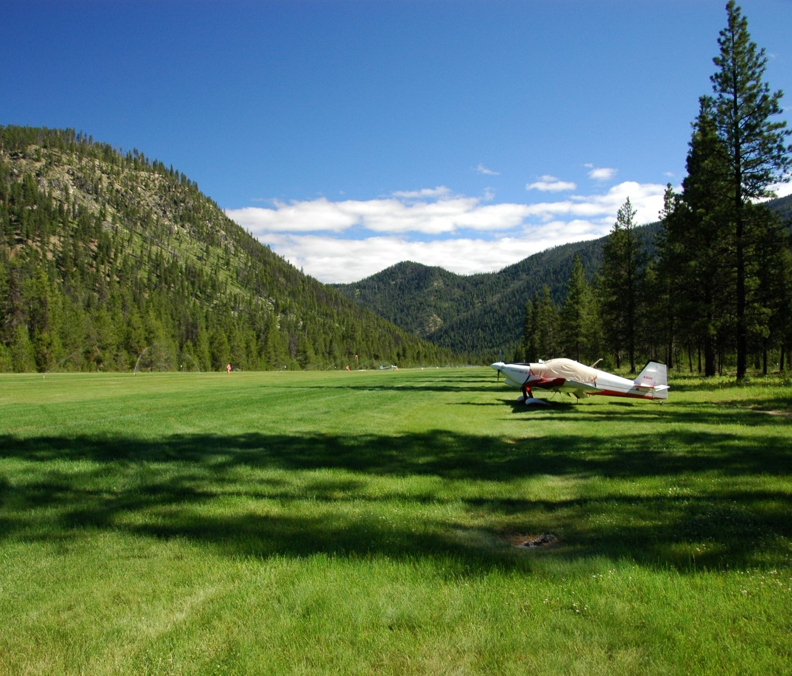
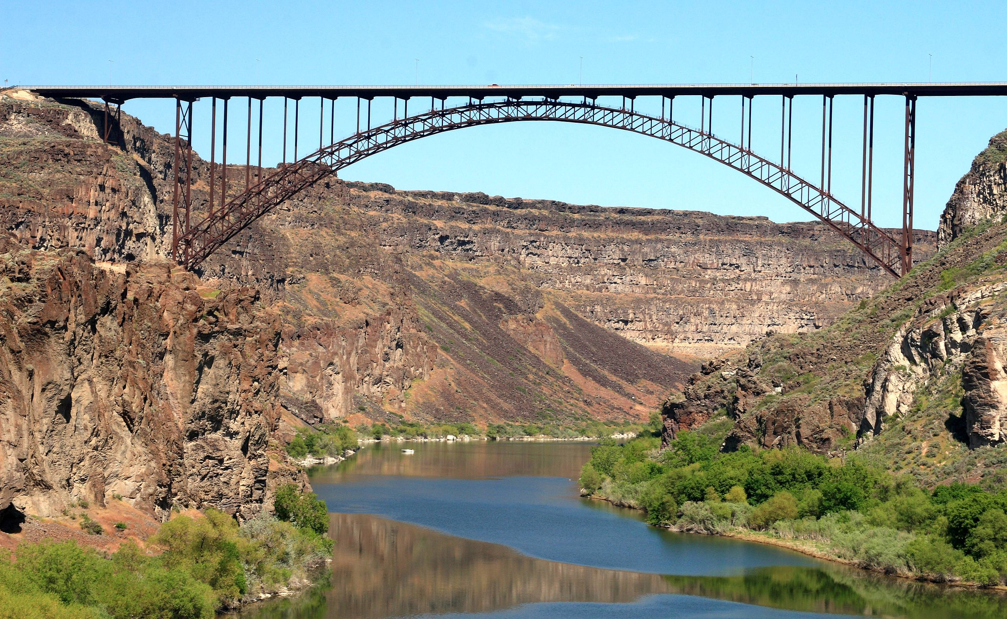
Data Standards
IGC-EC Nominations for Bridge and Airports
Approval at next IGC-EC Meeting
Documentation Complete

Slide 5
MIRE Data Standards - Will Thoman -

Slide 6
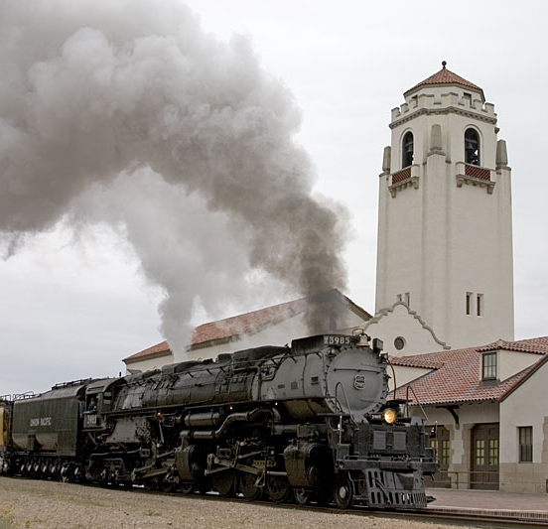
Railroad Data - Blaine Schwendiman-

Slide 7
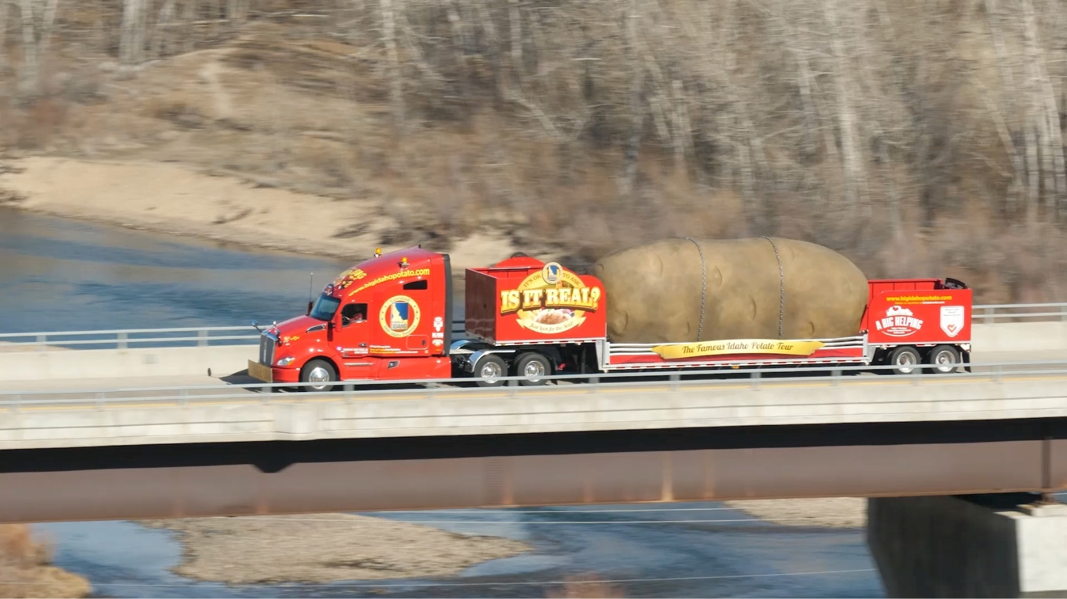
Freight Data - Caleb Forrey-

Slide 8
Next Meeting
May 2nd 2023
10:00 am to 11:00 am MST

Slide 9
QUESTIONS?? Contact Information: Sydney.Lewis@itd.idaho.gov

