Slide 1
National Geodetic Survey’s
Modernization of the National Spatial Reference System (NSRS):
Idaho Geospatial Council Fall Meeting
Oct. 13, 2021
Daniel Determan
Northwest Regional Geodetic Advisor (WA, OR, ID)
dan.determan@noaa.gov
206-526-6874(o); 202-306-6716(m)
Notes:
-Good afternoon everyone. Thank you for attending this presentation on replacing NAD83 with new horizontal datums, as part of NGS’s Modernization of the National Spatial Reference System (NSRS).

Slide 2
Who is NGS?
Federal Government – Executive Branch
-Department of Commerce (DoC)
(~47,000 employees)
-National Oceanic and Atmospheric Administration (NOAA)
-National Ocean Service (NOS)
-National Geodetic Survey (NGS)
(~175 employees)
Notes:
*We are the Federal Government’s oldest scientific agency.
We began as Survey of the Coast in 1807
Became the Coast Survey in 1836
Then the Coast and Geodetic Survey in 1878
And finally National Geodetic Survey in 1970

Slide 3
U.S. Department of Commerce (DOC) National Oceanic & Atmospheric Administration (NOAA)
National Ocean Service (NOS) National Geodetic Survey (NGS)
Mission: To define, maintain & provide access to the
National Spatial Reference System (NSRS)
to meet our Nation’s economic, social & environmental needs
Latitude
Longitude
Height
Scale
Gravity
Orientation
NSRS
NSRS
& their time variations
Notes:
NGS’s mission is to define, maintain and provide access to…
NGS develops and maintains the National Spatial Reference System, a national coordinate system that provides the foundation for transportation, navigation, land record systems, mapping and charting efforts, and a multitude of other scientific and engineering applications.
There are many other ancillary programs and products as well.
The NSRS defines position (latitude, longitude, and elevation), distances and directions between points, the strength and direction of gravity, and how they change over time, across the US and its territories.
There will also be other parameters and models that contribute to the Modernized NSRS, such as Euler Pole Parameters (EPP2022), Deflection Of the Vertical (DOV2022), Intra-Frame Velocity Model (IFVM2022), and others. Some of these I will talk about today.

Slide 4
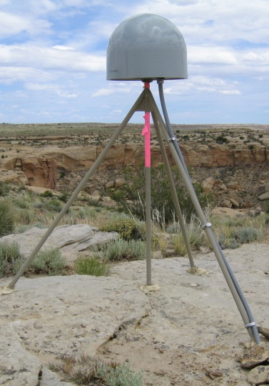
National Spatial Reference System Ties It All Together
LiDAR
Digital Terrain Model
Aerial Photography
Cartography
Parcels/Surveys
Engineering
Laser Scan Model
Satellite Imagery
Hydrography
Natural Resources
Horizontal / Vertical Control
(NSRS)
P028 2005
BUTTERMILK 1833
Notes:
The NSRS is the mathematical foundation layer that ties it all together
If NGS (or its predecessors*) did not make it, it is not part of the NSRS**
* Survey of the Coast (1807-1836)
Coast Survey (1836-1878)
Coast and Geodetic Survey (1878-1970)
National Geodetic Survey (1970-Present)
** The term “NSRS” was adopted in 1994, but today is used to encompasses all historic datums of NGS and its predecessors. Though the FGCS regularly adopts the latest components
WGS84, ITRF and IGS coordinate systems are examples that are not part of the NSRS
Buttermilk 1833 oldest know passive marker in the NSRS

Slide 5
National Spatial Reference System (NSRS)
These items ARE part of the NSRS
Horizontal Datums (aka Geometric Reference Frames) | Vertical Datums | Great Lakes Datums | Geoid Models | Transformations and Conversions
NAD83 | NAVD88 | IGLD85 | GEOID12A & B | NADCON
NAD27 | NGVD29 | IGLD55 | GEOID09 | VERTCON
USSD | VIVD09 |  | GEOID06
 | GUVD04 |  | GEOID03 | SPCS83
 | NMVD03 |  | GEOID99 | SPCS27
 | ASVD02 |  | GEOID96
 | PRVD02 |  | ALASKA94
 |  |  | GEOID93
 |  |  | GEOID90
Notes:
Note the US Standard Datum, anyone done any work in the old USSD?
Good example highlighting that the term “NSRS” is used to encompass all historic datums of NGS and its predecessors.
All those vertical datums below NGVD29, I greyed them out slightly because those are all Caribbean and Pacific Island datums, so in CONUS it’s just those two that you hopefully already use… and hopefully are mostly using NAVD88.

Slide 6
National Spatial Reference System (NSRS)
These items are NOT part of the NSRS
Horizontal Datums (aka Geometric Reference Frames) | Vertical Datums | Geoid Models | Transformations and Conversions
WGS84 | IHRS (by IAG) | OSU91A | CORPSCON
WGS72 |  | EGM96 | Appendix B.6 of DMA TR 8350.2 (WGS 84)
ITRF (Intl. Terrestrial Reference Frame by IERS) |  | EGM2008 | Oregon Coordinate Reference System (ORCS)
IGS (Intl. GNSS Service reference frame) |  |  | The Kansas Regional Coordinate System
Hyperlink to ITRF station map
Notes:
WGS is a DoD system. Yes, that is the system native to the Global Positioning System, but it isn’t true that you “have to” work in WGS84 to get the most accurate coordinates. I’ve heard people say that.
The Intl. Terrestrial Ref. Frame is a product of the Intl. Earth Rotation and Reference Systems Service. More on that later.
The Intl. GNSS Service Ref. Frame is, well, it’s a reference frame based on that ITRF just mentioned, but with improvements, like a more dense network of stations and is more easily accessible.
The IHRS is an International Height Reference System, which is a product that was formally adopted by the IAG (Intl. Association of Geodesy) in 2015. Not an NGS product but folks from NGS were involved.
OSU geoid, it was a research thing and I don’t know much about it.
The Earth Gravity Models are DoD products just like the WGS products, used around the world by our Nation’s military… but are not at all tied to NSRS geoids. Future DoD geoid models may have a closer tie to future NGS geoid models.
CorpsCon. Ah yes, Corpscon. Everyone loves Corpscon, unfortunately as convenient as it is it isn’t truly an NGS product and has not been updated in well, a long time, and there are no plans to update it in the future. (confirmed via phone call to AGC personnel on 20FEB2019)
The USACE doesn’t seem to want to update Corpscon. So it is what it is.
Those regional coordinates systems, like the ORCS in Oregon and that one in Kansas, although they have rigorously defined transformations to the NSRS (which is great, they did it right) they are not part of the NSRS.

Slide 7
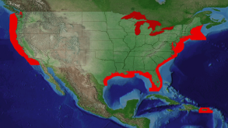
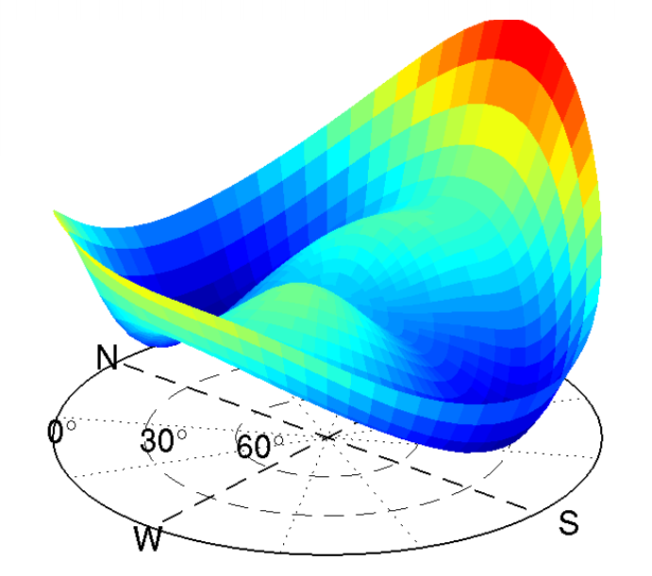
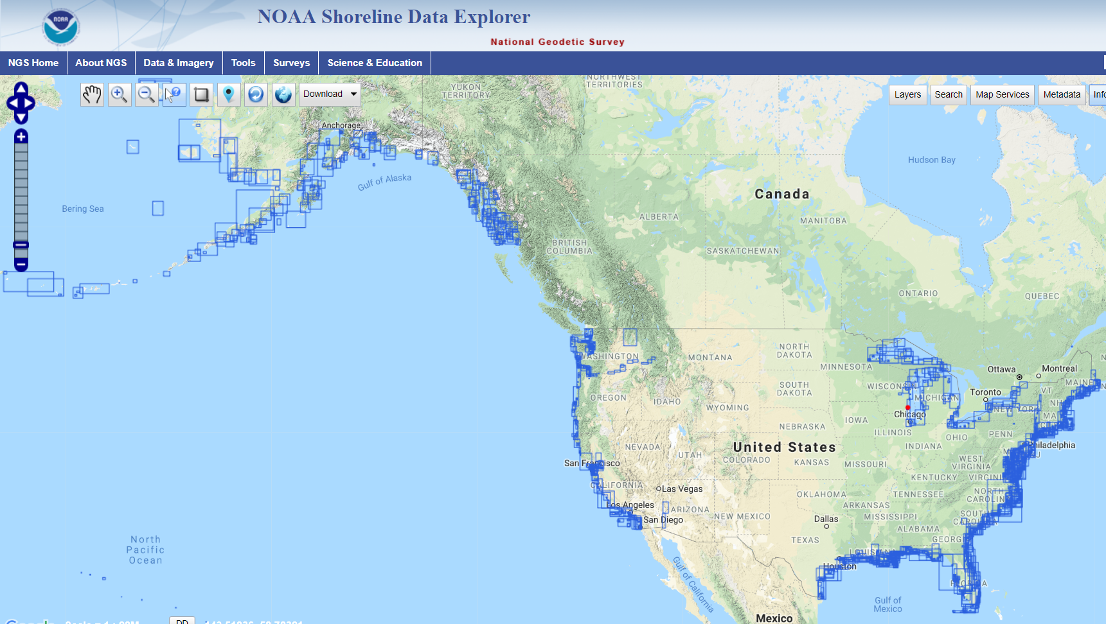
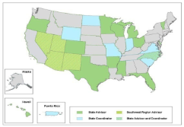
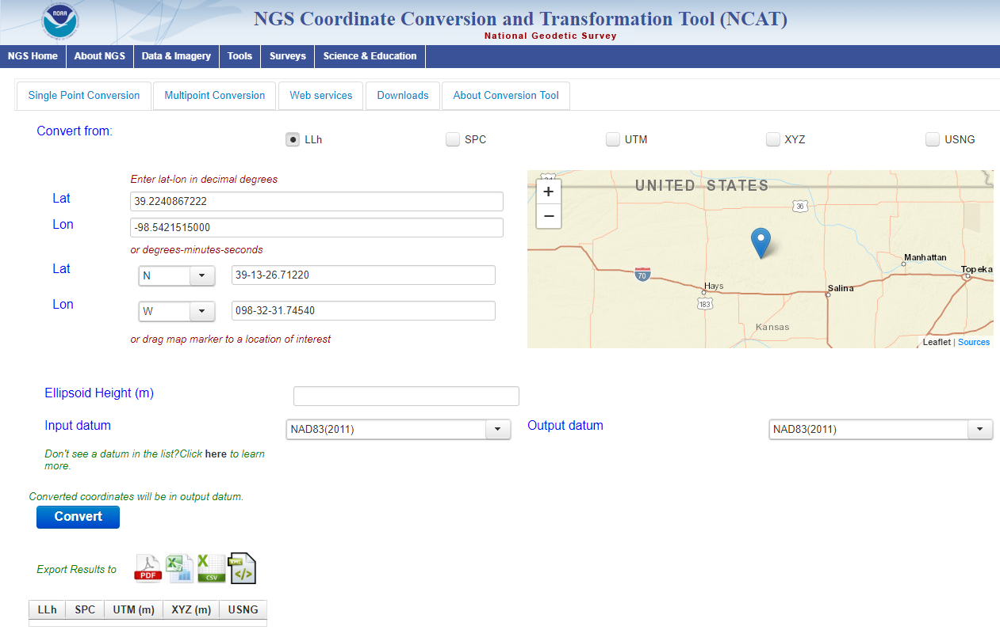
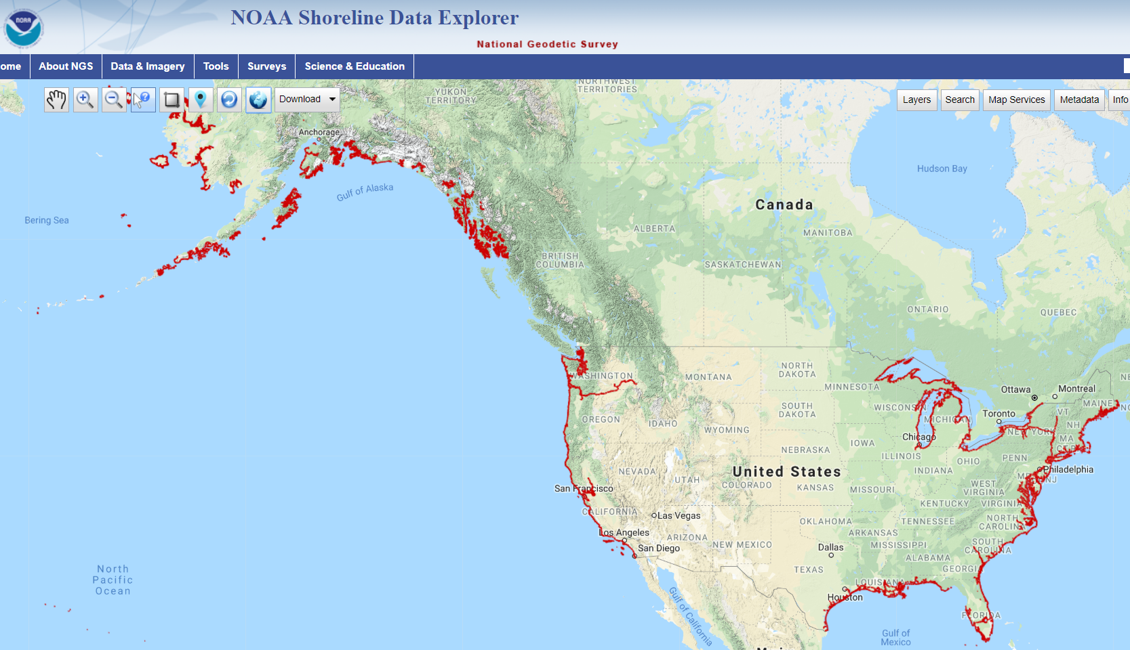
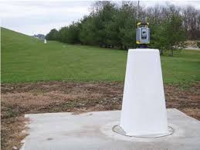
NGS Overview
Modernizing the NSRS
CORS
NHMP
GRAV-D
ECO
NGS Products and Services
ASP
OPUS
VDatum
Orbit Data
National Shoreline
Geodetic Advisors
ERI
Antenna Calibrations
NCAT
CUSP
CBL
Outreach/COMET
Notes:
This is not an exhaustive list of all NGS programs.

Slide 8
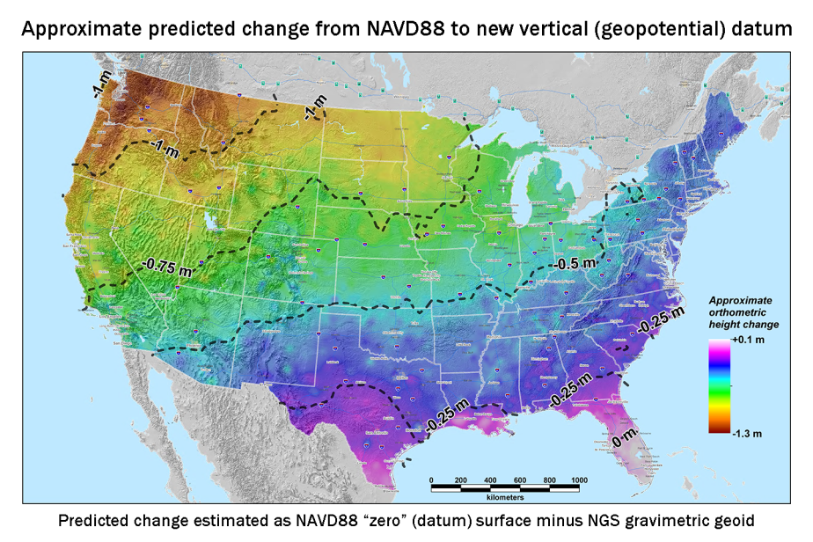
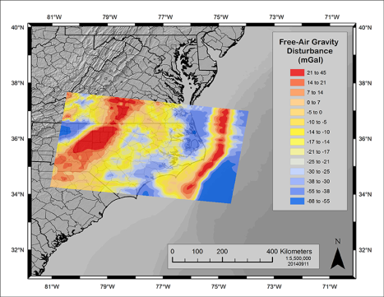
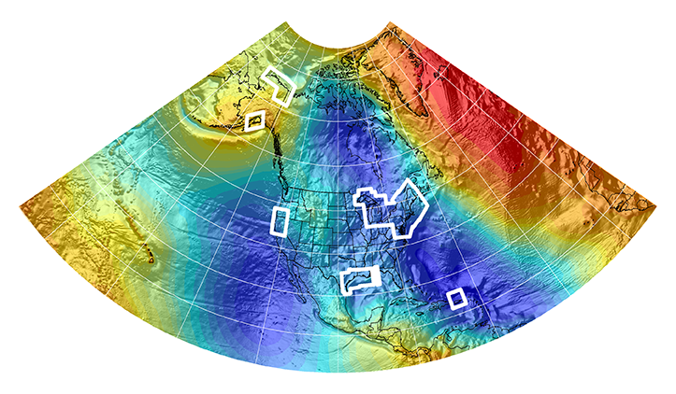
New Datums Are Coming in 2024/2025!
NOAA’s National Geodetic Survey will release new geometric (horizontal) and geopotential (vertical) datums
The realization of the new datums will be through GPS/GNSS receivers and will replace the current datums:
NAD 83 (geometric) and NAVD 88 (geopotential)
Target: 2-centimeter accuracy relative to sea level (orthometric heights) using GPS/GNSS and a geoid (gravity) model from NGS’ GRAV-D project.
NGS will provide the tools to easily transform between the new and old datums.
MORE INFO:
New Datums Webpage and Videos: http://www.geodesy.noaa.gov/datums/newdatums/NewDatums.shtml
Notes:
The new datums will be accessed via GNSS technology versus traditional benchmarks
Current datums are not perfect and do not fully support current (and future) technology (such as GPS and Lidar)
New datums will replace NAD83 and NAVD88 ....
Target 2 centimeter relative to sea level (ortho hts) using GPS/GNSS and the geoid (gravity from GRAV-D).
We will provide the tools for transformations.
New geopotential (vertical) datum to be released in 2024/2025 will be a gravimetric geoid. Airborne gravity data for the geopotential datum collected by the Gravity for the Redefinition of the American Vertical Datum (GRAV-D) Project will allow for blending of data from satellite, altimetric, and surface sources. Both datums will be released together in 2024/2025.
Estimated Differences Between “Old” and “New” Datums:
Geometric Datum
Horizontal: 0.8 to 1.5 m in CONUS
Ellipsoidal heights: -0.2 to -1.6 m CONUS; AK 0 to 1.3 m
Geopotential Datum
Approx. +0.1 m (Florida) to -1.3 m (Washington)
More than 2 meters of change in Alaska
More info is available at the NGS New Datums Webpage. It has been eleven years since NGS held its first Geospatial Summit in 2010 to announce the replacement of the NAD 83(geometric) and NAVD 88 (geopotential) to other federal agencies within the mapping community. The May 2019 summit provided an opportunity to share updates on the new geometric and geopotential datums to the general public allowing the opportunity to address their comments, questions and concerns to NGS.
Picture: Map reflects the type of height improvements users could expect if NAVD 88 were replaced with a geoid-based vertical datum. (This is only a large scale approximation and should not be used as an absolute guide. Each benchmark might have its own level of mismatch, for example from uplift or subsidence, not captured by this broad brush. Also, this is the difference between the zero level of NAVD 88 and the actual geoid. The difference between NAD 83 ellipsoid heights and ITRF/GRS-80 ellipsoid heights has NO influence on this graph and should not be part of the story.)
Picture: xGEOID14B. Beginning in 2014, the National Geodetic Survey will release annual gravimetric geoid models which incorporate all available gravity sources, including all airborne gravity collected through the GRAV-D project to that point. The image above shows the xGEOID14B model with the boxes showing the location of the input aerogravity data. These experimental geoid models will provide the public with the opportunity to evaluate how the geopotential (vertical) datum in their area will change when the new datums arrive.
Picture: GRAV-D data block for North Carolina. More than 50 percent of the U.S. and its territories have been covered by GRAV-D airborne data collection.

Slide 9
Not just new datums…
NSRS Modernization
Replace NAD83
Replace NAVD88
Re-invent Bluebooking
Improve Geodetic Toolkit
Better Surveying Methods
Blueprint for 2022, Part 1
Blueprint for 2022, Part 2
Blueprint for 2022, Part 3
Notes:
-so you’ve probably seen that phrase that I have front and center here, NSRS Modernization
-that’s the blanket term we use to refer to not just the new datums but other updates
-another thing I want to mention here are the “Blueprints for 2022”
-just about everything I cover today is mentioned in Blueprint Part 1, geometric coordinates.
-the Geodetic Toolkit is another term that just refers to all the software NGS provides, like PAGES, ADJUST, etc.
-better surveying methods includes updating manuals like NGS-58 and 59 for example

Slide 10
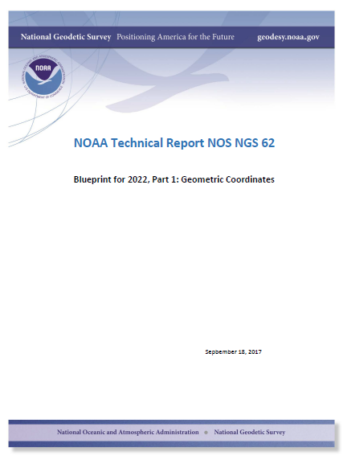
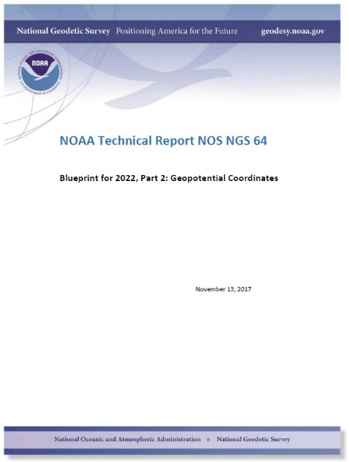
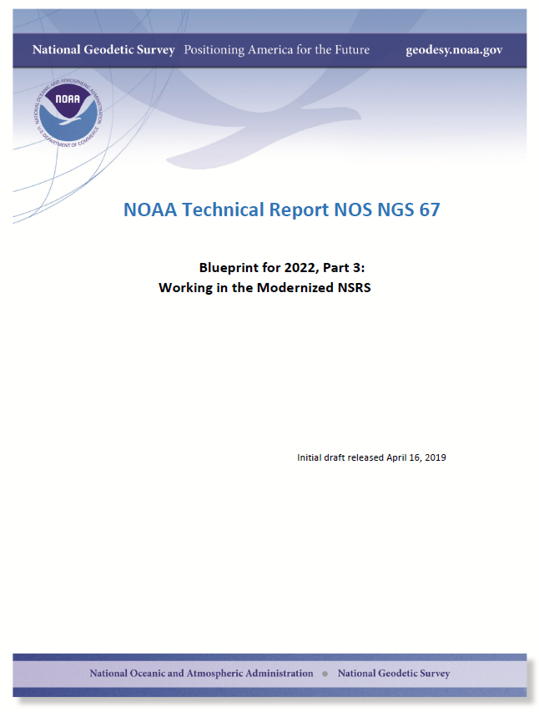
Modernizing the NSRS
The “blueprint” documents: Your best source for information
Geometric:
Sep 2017
NOAA TR NOS NGS 62
32 pages
Geopotential:
Nov 2017
NOAA TR NOS NGS 64
41 pages
Working in the modernized NSRS:
July 2019
NOAA TR NOS NGS 67
77 pages
Notes:
This slide shows the 3 blueprint documents:
BP Part 1 Geometric Coordinates (NOAA TR NOS NGS 62)
BP Part 2 Geopotential Coordinates (NOAA TR NOS NGS 64)
BP Part 3 Working in the Modernized NSRS (NOAA TR NOS NGS 67)

Slide 11
Two Major Components of Modernized NSRS
Geometric (LLh)
Geopotential (H)
Notes:
-geometric component is latitude, longitude, and ellipsoid height
-geopotential component is combined with the geometric components to calculate an orthometric height or capital H
*Today’s presentation will focus only on the Geometric component of the Modernized NSRS, or Replacing NAD83*

Slide 12
Replacing NAD83
develop four "plate-fixed" reference frames
remove non-geocentricity of NAD83
align to ITRF2014 at epoch 2020.00
remove most of tectonic plate rotation from ITRF2014 via Euler Pole Parameters
(pronounced: “oiler”)
Shift and Drift…
Notes:
-Modernizing the NSRS requires 4 geodetic tasks:
1) Develop 4 plate-fixed reference frames
2) Remove Non-Geocentricity of NAD83
3) Align to ITRF2014 at epoch 2020.00
4) Remove most tectonic plate rotation from ITRF2014 via Euler Pole Parameters
-we will also account for the “shift and drift”, mentioned at the bottom.

Slide 13
Replacing NAD83
develop four "plate-fixed" reference frames
remove non-geocentricity of NAD83
align to ITRF2014 at epoch 2020.00
remove most of tectonic plate rotation from ITRF2014 via Euler Pole Parameters
(pronounced: “oiler”)
Shift and Drift…
Notes:
First, we must develop four “plate-fixed” reference frames.

Slide 14
Four “Plate-Fixed” Reference Frames
North American Terrestrial Reference Frame of 2022
(NATRF2022)
Pacific Terrestrial Reference Frame of 2022
(PATRF2022)
Caribbean Terrestrial Reference Frame of 2022
(CATRF2022)
Mariana Terrestrial Reference Frame of 2022
(MATRF2022)
Notes:
The four plate-fixed reference frames will be the North American, Pacific, Caribean, and Marianas Terrestrial Reference Frames of 2022
-We refer them as “plate-fixed” because the frame moves with the plate, so that we minimize time-based coordinate shift.

Slide 15
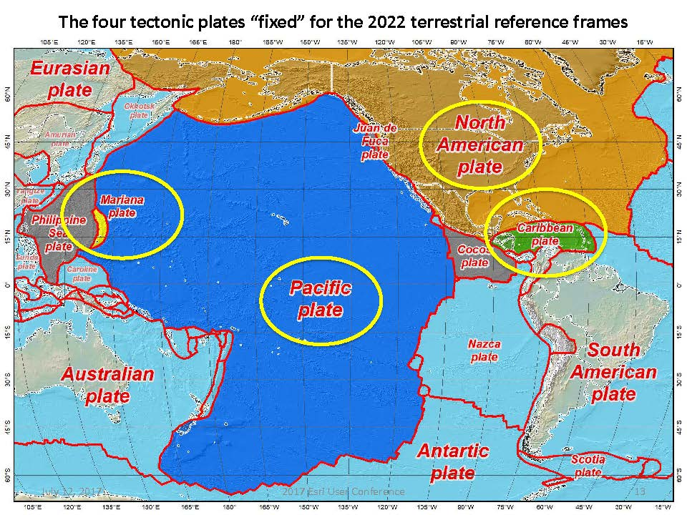
Notes:
-there are four reference frames because there are four major tectonic plates within the NGS Area of Responsibility.
-As the National Geodetic Survey, we’re part of the DoC so we must cater to all US States and Territories
-thus we’ve got four tectonic plates in our Area of Operations, so four Ref Frames

Slide 16
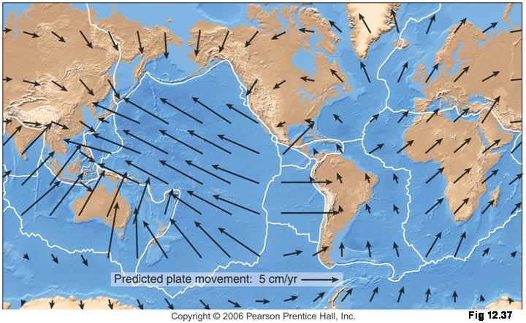
Four Frames/Plates in 2022
NATRF2022
MTRF2022
CTRF2022
PTRF2022
Image from UNAVCO
Notes:
This slide shows the predicted plate movement for the four reference frames.

Slide 17
Replacing NAD83
develop four "plate-fixed" reference frames
remove non-geocentricity of NAD83
align to ITRF2014 at epoch 2020.00
remove most of tectonic plate rotation from ITRF2014 via Euler Pole Parameters
(pronounced: “oiler”)
Shift and Drift…
Notes:
The second task is to remove the non-geocentricity of NAD83. This will cause a “shift” in coordinates.

Slide 18
Non-geocentricity of NAD83
Earth’s
Surface
h₁₄
h₈₃
NAD83
origin
ITRF2014
origin
~2.2 meters
GRS80
ellipsoid
Notes:
This diagram shows the non-egocentricity of NAD83
-It shows one quarter of an ellipsoid. Notice they are the same geometry (size, shape) but have different origins
-Fixing this will cause a “SHIFT” in coordinates.

Slide 19
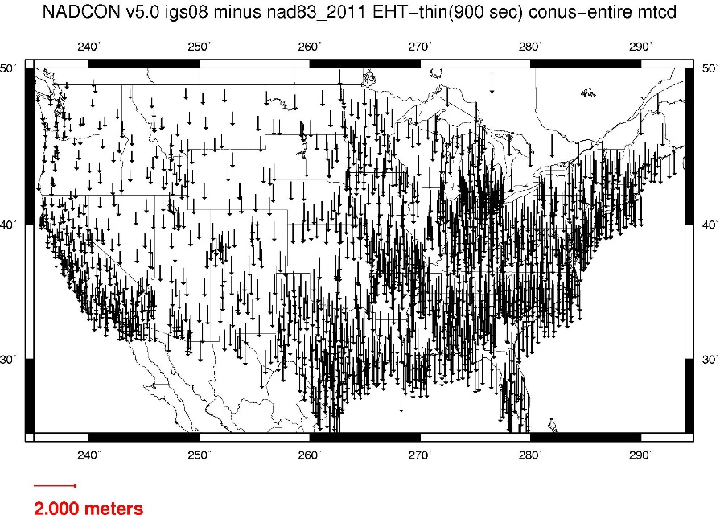
Geometric change due to ellipsoid non-geocentricity
Horizontal (Lat, Lon)
Ellipsoidal (h)
Shift…
Notes:
-Estimate of shift from NAD83(2011) epoch 2010.00 to NATRF2022 epoch 2020.00
-so this represents the positional shift due to non-geocentricity that we’re addressing/fixing
-now remember this is the Geometric component only, so the graphic on the right illustrates a somewhat constant shift because it is representing Ellipsoidal shift, not Orthometric
-Look at the size of those arrows, based on the scale bar there we’re looking at about 1 meter-ish lat,lon shift and somewhere around the same ellipsoidally around here
-REMEMBER, this is easy to address compared to geoid/ortho heights!

Slide 20
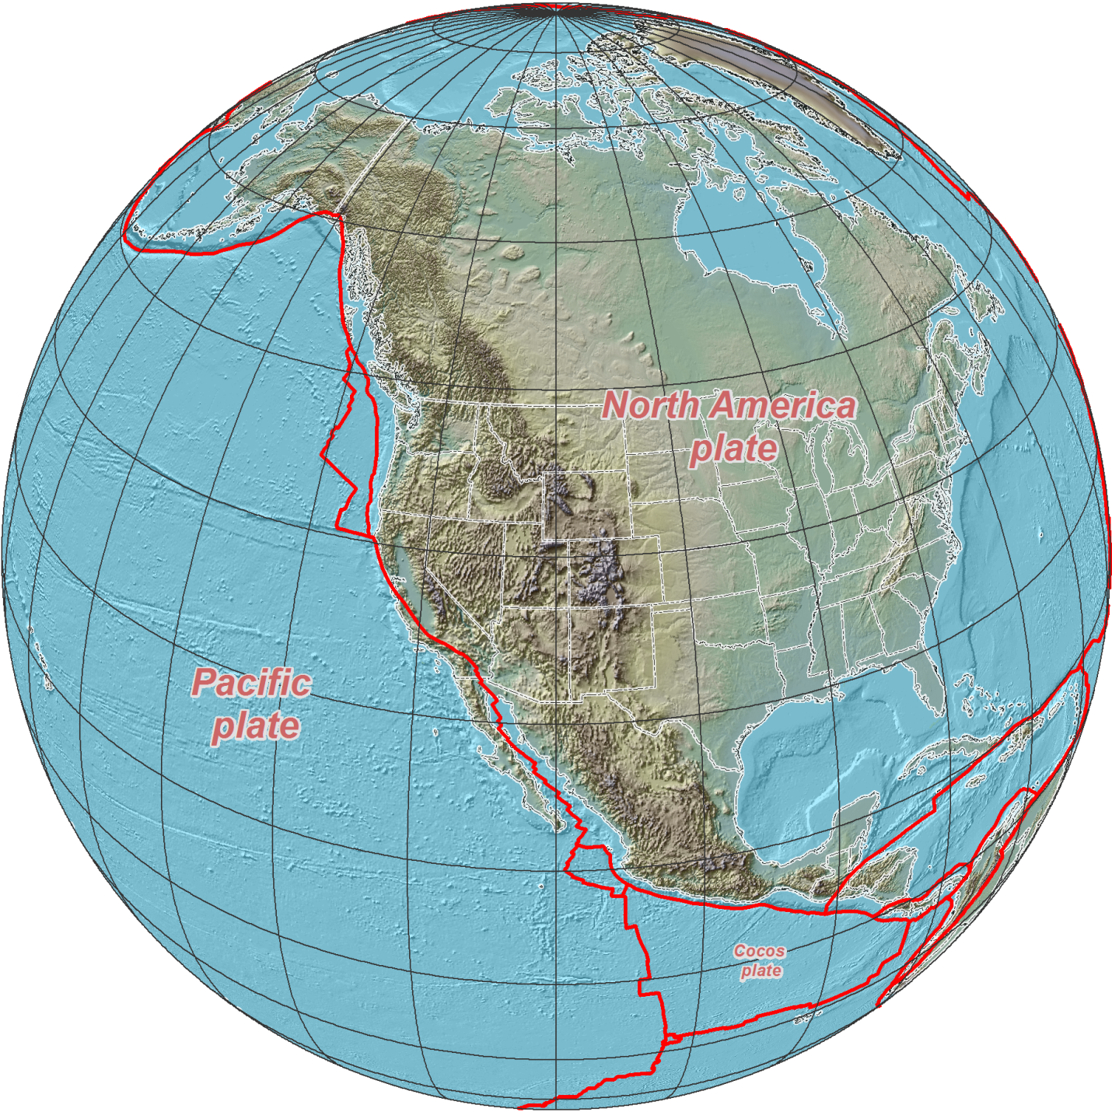
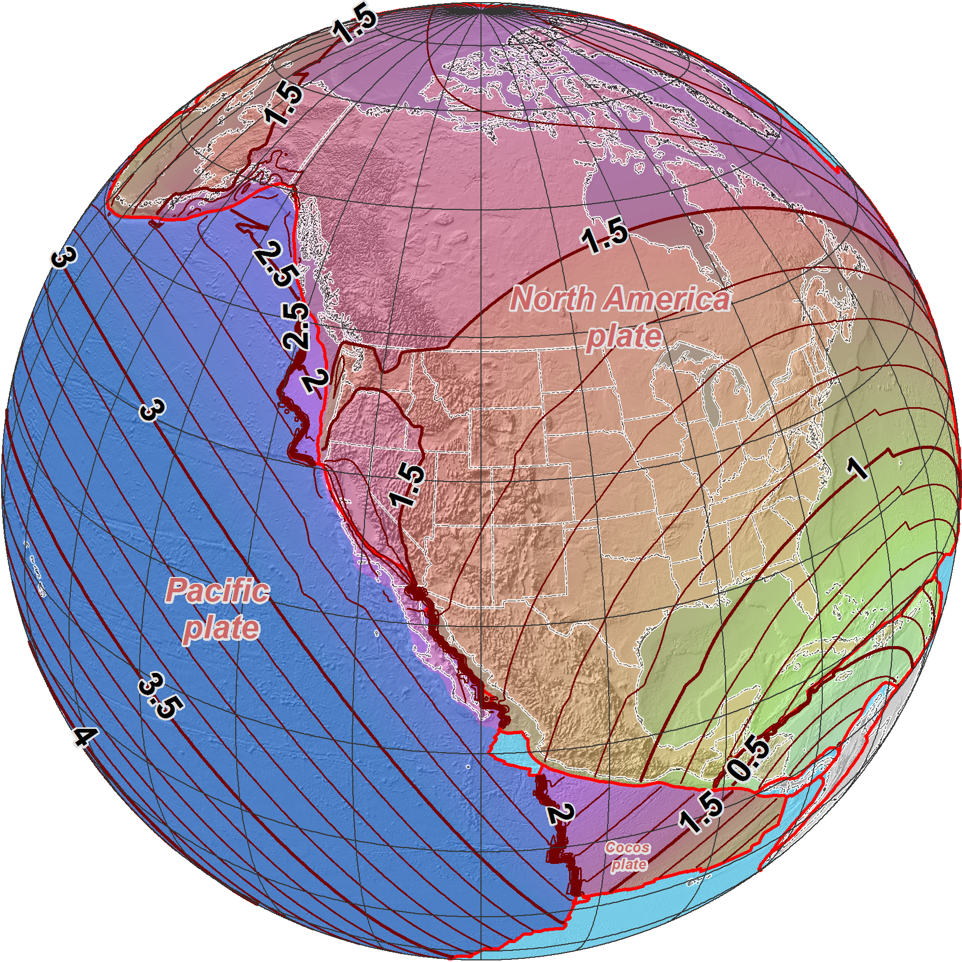
NAD 83 (2011/PA11/MA11) epoch 2010.00
→ 2022 Terrestrial Reference Frames
Horizontal change at epoch 2022.00
(contours in meters)
NATRF2022
PATRF2022
CATRF2022

Slide 21
Notes:
-what’s the Magnitude of Horizontal Change?
Estimated Differences Between “Old” and “New” Geometric Datums:
Horizontal: ~0.8 to 1.5 m in CONUS
-we will have tools online to simplify the process of estimating NAD83→NATRF2022

Slide 22
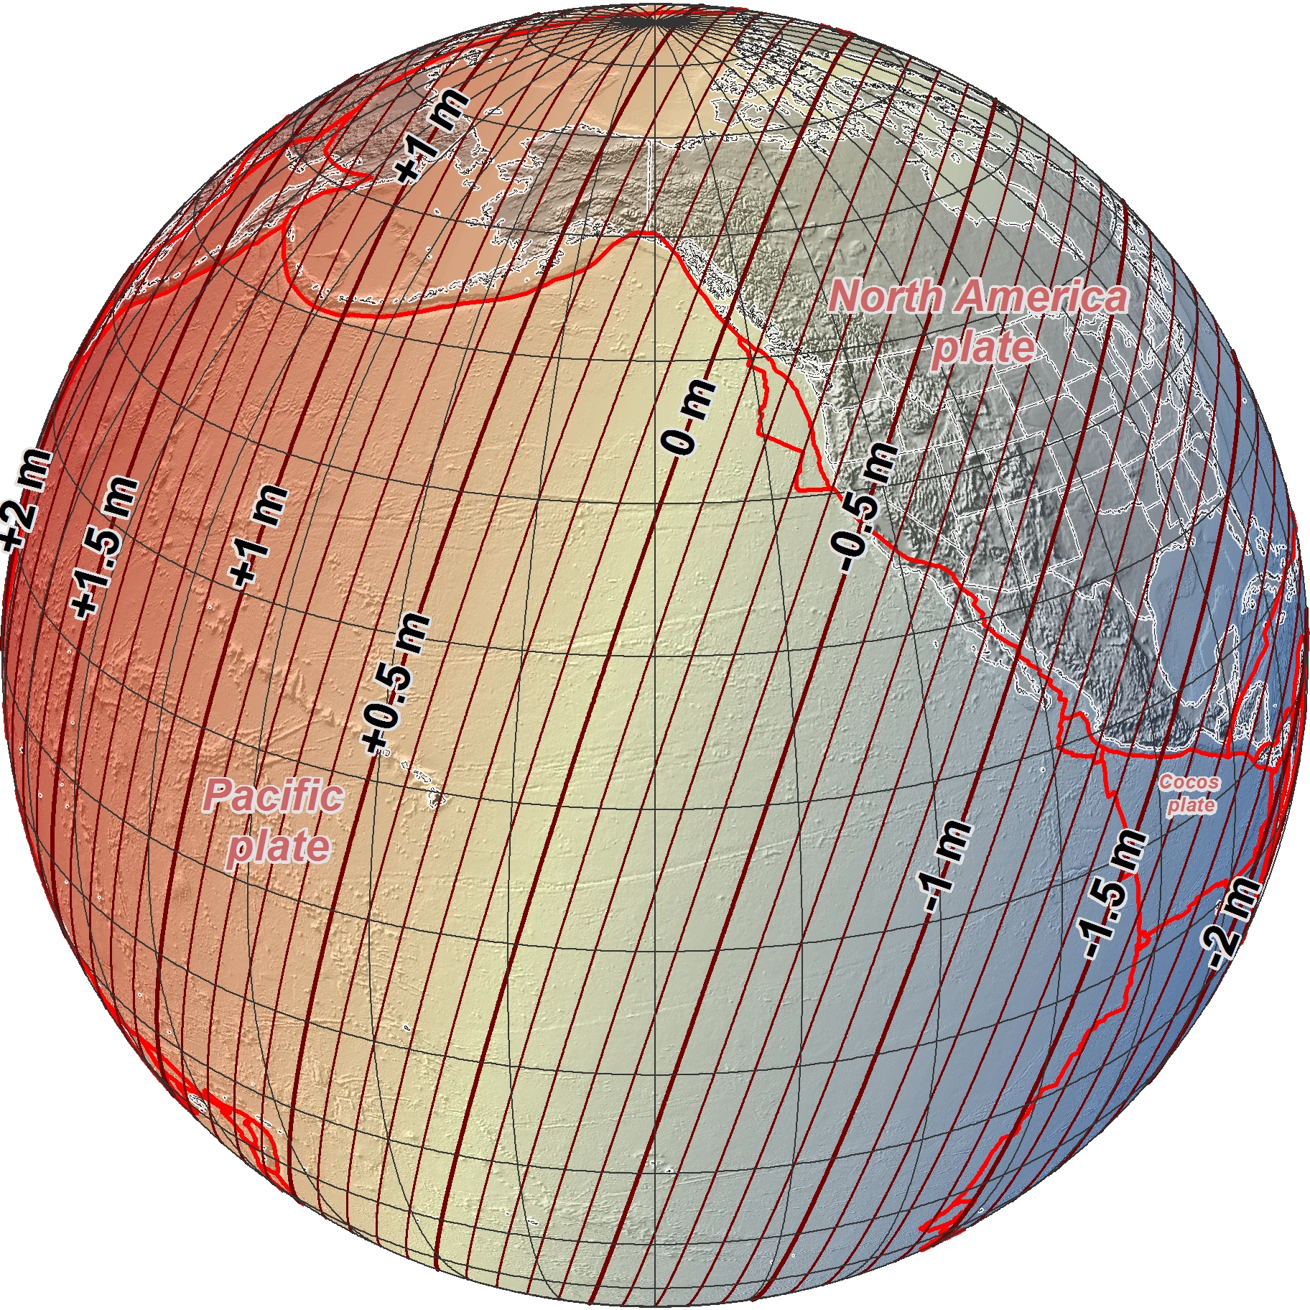
NAD 83 (2011/PA11/MA11) epoch 2010.00
→ 2022 Terrestrial Reference Frames
Change in ellipsoid heights at epoch 2022.00
(contours in meters)
NATRF2022
MATRF2022
PATRF2022
Notes:
Estimated Differences Between “Old” and “New” Geometric Datums:
Ellipsoidal heights: -0.2 to -1.6 m CONUS; AK 0 to 1.3 m

Slide 23
Replacing NAD83
develop four "plate-fixed" reference frames
remove non-geocentricity of NAD83
align to ITRF2014 at epoch 2020.00
remove most of tectonic plate rotation from ITRF2014 via Euler Pole Parameters
(pronounced: “oiler”)
Shift and Drift…
Notes:
The IGS/IGb08 Reference Frame is pretty much equivalent to the ITRF, created by the Intl. GNSS Service, of which NGS is a contributing partner.

Slide 24
International Terrestrial Reference Frame
The stable coordinate system that allows us to measure change over space, time and evolving technologies.
An accurate, stable set of station positions and velocities.
Network measurements interconnected by co-location of different space geodetic techniques.
“Approximately represents the motions of the tectonic plates with respect to the Earth's deep interior”
Notes:
What is the International Terrestrial Reference Frame
(ITRF)?
You’ve heard me mention the ITRF, but if you’ve been paying attention to OPUS Solution Reports you may’ve noticed the ITRF2014 coordinates over on the right hand side
Let’s try to visualize the ITRF. Last bullet,

Slide 25
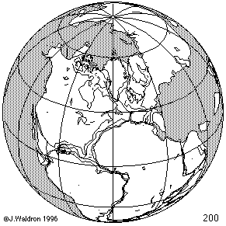
ITRF concept
Watch the grid!
Drift…
Notes:
Most simplistic way to explain ITRF is to watch this animation.
This is a very loose representation/visualization of what the ITRF is, a characterization only.

Slide 26
Replacing NAD83
develop four "plate-fixed" reference frames
remove non-geocentricity of NAD83
align to ITRF2014 at epoch 2020.00
remove most of tectonic plate rotation from ITRF2014 via Euler Pole Parameters
(pronounced: “oiler”)
Shift and Drift…

Slide 27
Two types of drift
Tectonic Plate Rotation
horizontal
Everything Else
residual motions left after rotation
regional linear motions
localized subsidence or uplift
simple to model
complex
Notes:
-there’s two types of drift you’ll see
Tectonic Plate Rotation
Everything Else (residual motions, regional linear motions, localized subsidence or uplift, glacial isostatic adjustment, etc.)

Slide 28
Tectonic Plate Rotation
horizontal
simple to model
Notes:
-Tectonic Plate Rotation is relatively simple to model

Slide 29
Euler Pole Parameters
of 2022
EPP2022
Notes:
We will use EPP2022 to accommodate for tectonic plate rotation.

Slide 30
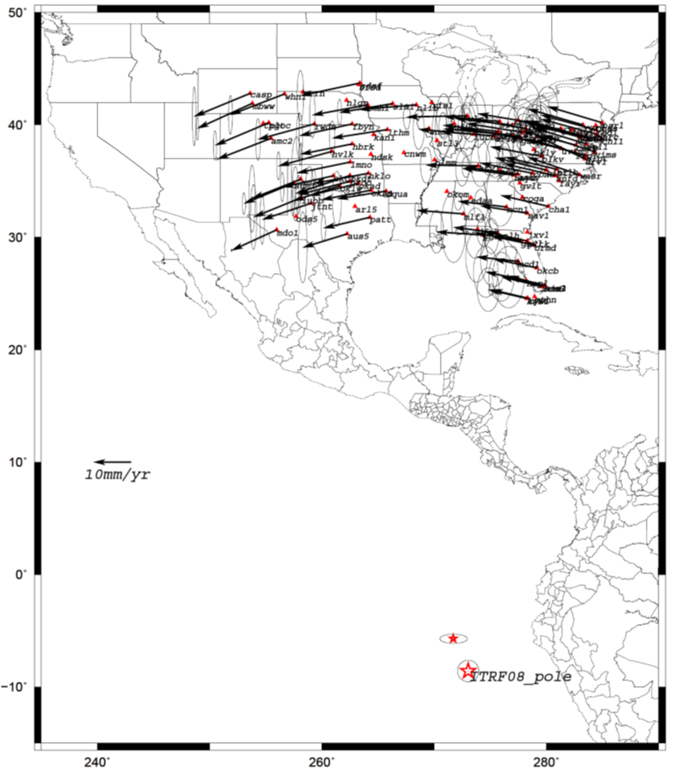
Euler Poles and “Plate-Fixed”
In the ITRF, many tectonic plates have a dominant motion: rotation
Euler Pole - point about which a plate rotates (yellow star)
NATRF2022 Euler Pole
Notes:
-these are ground-level horizontal velocities
-the arrows illustrate the positions and velocities of CORS plotted in ITRF2014
-our scale is on the left there, with that arrow representing 20mm of motion per year
-what do we notice about the direction of these arrows?
-they look rotational, don’t they?
-so when you look at those arrows you can see the rotation, but the point of rotation is obviously off the map, way down below the screen right?
-that point is what’s known as an Euler Pole
We say “NATRF2022” is “fixed” to the N.A. Plate, making it a “plate fixed” frame
-the frame is constant to itself, but rotating within ITRF, and moving in a different direction than the other 3 frames

Slide 31
EPP – Euler Pole Parameters
Latitude
Longitude
Rotation Speed
yellow star off west coast of S. America
Notes:
These are the components that make up the euler pole parameters
Latitude
Longitude
Rotation Speed

Slide 32
Euler Poles and “Plate-Fixed”
ITRF
Frame = constant
NA Plate = rotating
NATRF
Frame = rotating
NA Plate = constant
Notes:
We say “NATRF2022” is “fixed” to the N.A. Plate, making it a “plate fixed” frame
-the frame is constant to itself, but rotating within ITRF, and moving in a different direction than the other 3 frames

Slide 33
Euler Poles and “Plate-Fixed”
ITRF
Frame = constant
NA Plate = rotating
NATRF
Frame = rotating
(relative to ITRF)
NA Plate = constant
(relative to NATRF2022)

Slide 34
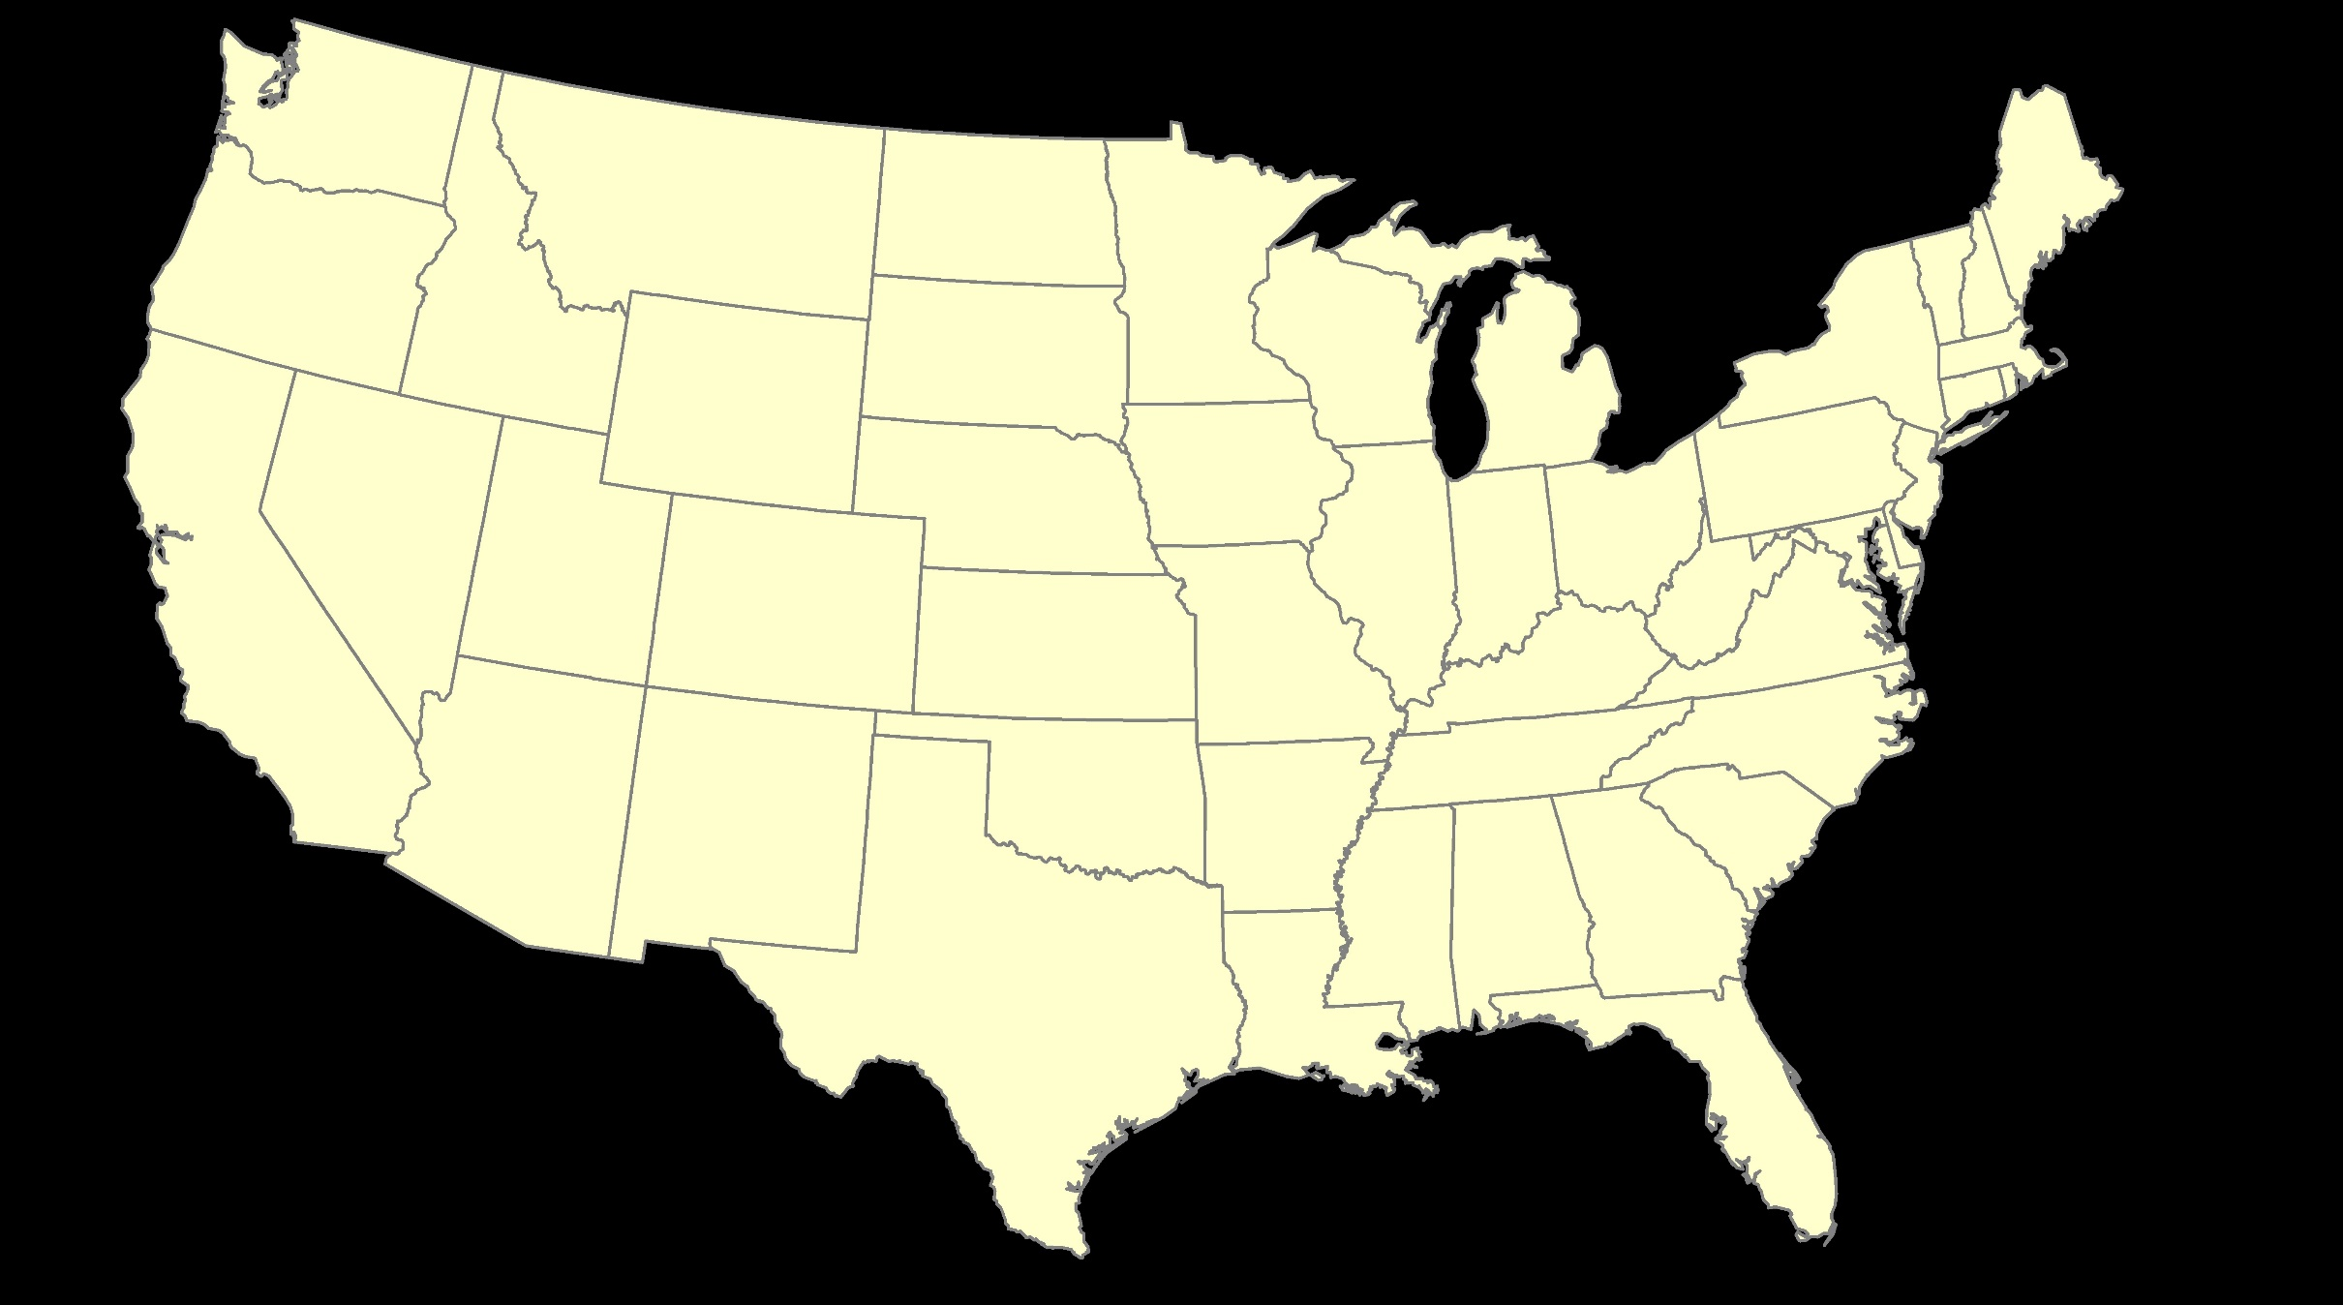
ITRF – constant frame, rotating plate

Slide 35
“Plate-Fixed”
NATRF – rotating frame, constant with plate

Slide 36
ITRF or NATRF – your choice, just use EPP

Slide 37
CORS Velocities in ITRF2014
Drift…

Slide 38
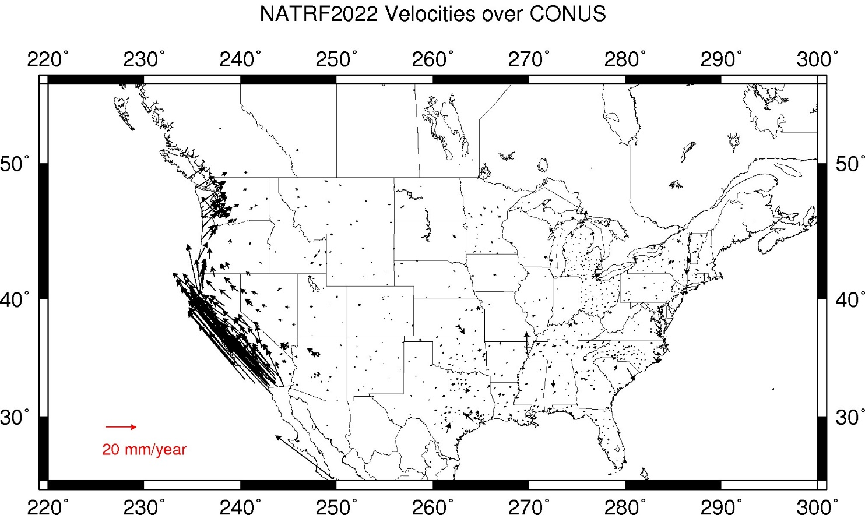
CORS Velocities in NATRF2022
Think of this map as ITRF2014 + EPP2022
Still SomeDrift…
Notes:
These velocities the motion that is left after removing Euler Pole rotation via it’s defining parameters, known simply as Euler Pole Parameters or EPP
These small bare visible arrows in our region are residual velocities leftover after modeling that Euler pole, which will then be modeled into the IFVM for NATRF2022.

Slide 39
ITRF2014 + EPP2022 = --TRF2022
Rotation of the
North American Plate
North American Terrestrial Reference Frame of 2022
(NATRF2022)
Caribbean Terrestrial Reference Frame of 2022
(CATRF2022)
Pacific Terrestrial Reference Frame of 2022
(PATRF2022)
Mariana Terrestrial Reference Frame of 2022
(MATRF2022)
Rotation of the
Caribbean Plate
ITRF2014
Rotation of the
Pacific Plate
Rotation of the
Mariana Plate
EPP2022
Notes:
-So it all starts with ITRF
-OPUS is already running all your processing in ITRF, take a look at one of your recent solution reports and you’ll see ITRF2014 coordinates on the right hand side (or IGS/IGb08)
-Not just North America, Each plate gets a set of EPP associated with it, as each plate is rotating around a different Euler Pole

Slide 40
Everything Else
residual motions left after rotation
regional linear motions
localized subsidence or uplift
Still SomeDrift…
complex
Notes:
-The “everything else” is the complex part!

Slide 41
Intra-Frame Velocity Model of 2022
IFVM2022

Slide 42
Concept of goal of IFVM
Longitude (Easting) History of DI4044
Trend: -1.7 mm / year
RED IS NATRF2022
COORDINATE
Still Some Drift…
Trend: -14.3 mm / year
BLUE IS ITRF COORDINATE
2004 2006 2008 2010 2012 2014 2016 2018
Notes:
First look at that blue line, that is the velocity of DI4044 if we graph it’s easting coordinate in ITRF over 10+ years.
So look at the reddish line, that’s the longitude/easting of PID DI4044 after the EPP (rotation) is modeled and factored in, but before the IFVM is applied.
This is the velocity of the point in NATRF2022
Rotation of plate removed. It is not constant because the point still suffers small “intra-frame” velocities.
Such IFVs will be captured in a model by NGS.
The intent of the IFVM is to remove even that movement to better support coordinate comparisons, etc.

Slide 43
CORS Velocities in NATRF2022
Think of this map as ITRF2014 + EPP2022
Still SomeDrift…
Notes:
These are the CORS velocities in NATRF2022. It shows the motion that is left after removing Euler Pole rotation using it’s defining parameters, known simply as Euler Pole Parameters or EPP
The small bare visible arrows are residual velocities leftover after modeling that Euler pole, which will then be modeled into the IFVM for NATRF2022.

Slide 44
Still Some Drift…
Everything in the world moves
Coordinates will be associated with the actual date when the data was collected!
Velocities at all marks can be estimated using the IFVM
IFVM goal is to move collected data thru time to Reference Epochs for coordinate comparisons/analysis
Notes:
The IFVM is a model of all residual velocities, after removal of tectonic rotation via EPP
Horizontal residual motion
Total vertical motion (ellipsoid heights)
Glacial Isostatic Adjustment (GIA)
*The IFVM Replaces / Improves upon HTDP

Slide 45
EPP2022 IFVM2022
Two new tools that will make time dependent geodetic control practical
They work together to account for the Drift…
Notes:
EPP2022 and IFVM2022 are two new tools that work together to account for the “drift” in coordinates over time.

Slide 46
Majority of audience working in stable regions of North America…
North American Terrestrial Reference Frame of 2022
(NATRF2022)
Notes:
-remember, we covered 4 reference frames but if you’re just working in this region, you only have to be concerned with NATRF
-almost everything I’ve covered thus far is in this TR or Technical Report available on our website

Slide 47
How can surveyors prepare?
Research your published control
pre-1995? will NOT get new coordinates (GPS only)
Use OPUS Projects to re-observe/process
Set/occupy RTN Validation Stations (OPUS)
Get familiar with terms, ask now, be ready
Notes:
-dam sites (flood risk management and navigation) are perfect candidates
-retain central and local parameters…if you lose the parameters you’re screwed
-doesn’t require familiarity with the sites to design the projections, just analysis
-NGS is committed to having a tool in the Modernized NSRS in which users upload a set of projection parameters for OPUS solutions or other
**that tool will not be online in conjunction with 2022 rollout, it is lower on the priority list
-what’s the goal in this? to minimize the difference between grid and ground coordinates and distances, ideally to the point of being small enough to ignore.

Slide 48
How can GIS experts prepare?
start thinking about epochs/dates
Consider how you will store epoch dates
Maps in ITRF2014 for LLh changes
download xGEOID for elevation changes
could make difference on maps
Get familiar with terms, ask now, be ready
Time dependency - some datasets will be good with transformations
Notes:
-dam sites (flood risk management and navigation) are perfect candidates
-retain central and local parameters…if you lose the parameters you’re screwed
-doesn’t require familiarity with the sites to design the projections, just analysis
-NGS is committed to having a tool in the Modernized NSRS in which users upload a set of projection parameters for OPUS solutions or other
**that tool will not be online in conjunction with 2022 rollout, it is lower on the priority list
-what’s the goal in this? to minimize the difference between grid and ground coordinates and distances, ideally to the point of being small enough to ignore.

Slide 49
What new tools are already live?
VERTCON 3.0 – functionality in Beta NCAT
Mark Recovery – mobile browser compatible
VDatum 4.0.1 – just dropped early this year!
GEOID18 – latest, greatest, and last hybrid
GPSonBM – updated tracking map (AGOL)
for NAVD88→NAPGD2022 transformation
Notes:
-so you’ve probably seen that phrase that I have front and center here, NSRS Modernization
-that’s the blanket term we use to refer to not just the new datums but other updates
-another phrase I want to mention are these “Blueprints for 2022”
-just about everything I cover today is mentioned in one of the Blueprints
-the Geodetic Toolkit, what’s that? another term that just refers to all those softwares NGS provides, like PAGES, ADJUST, etc.
-better methods – updating manuals like NGS-58 and 59 for example

Slide 50
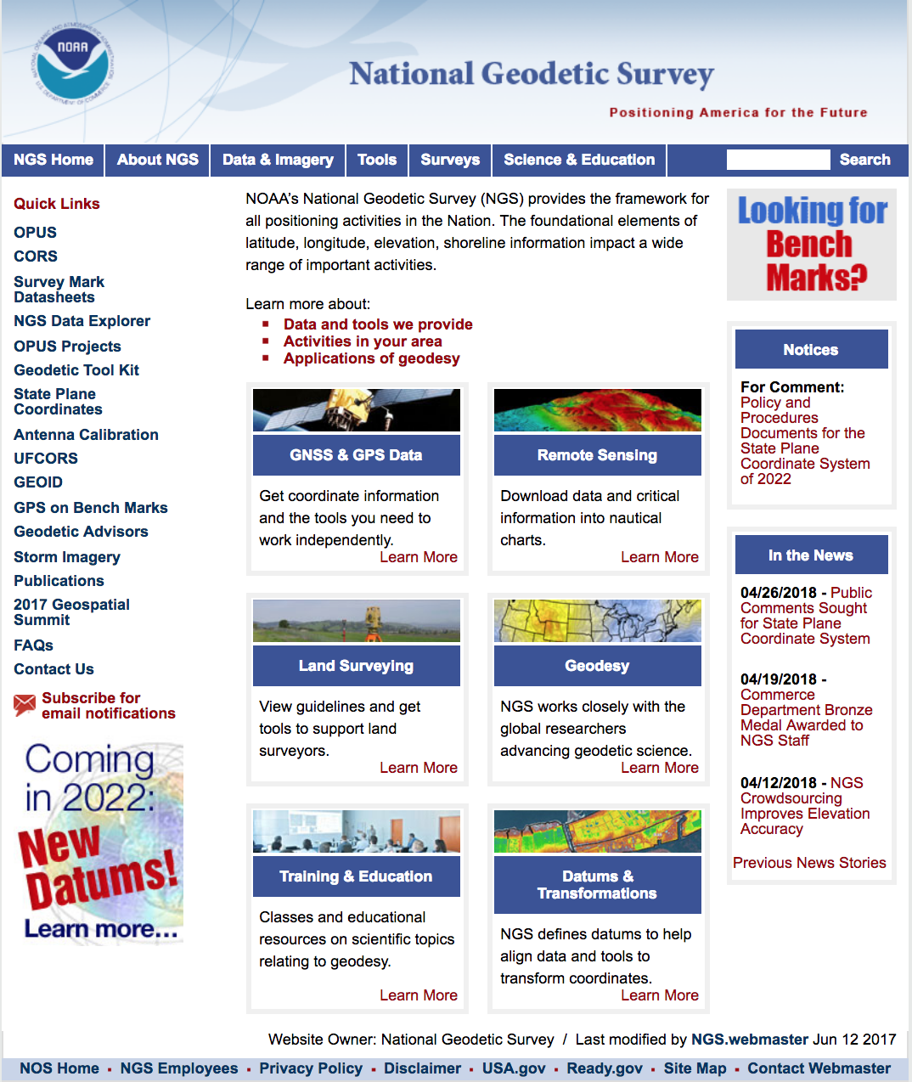
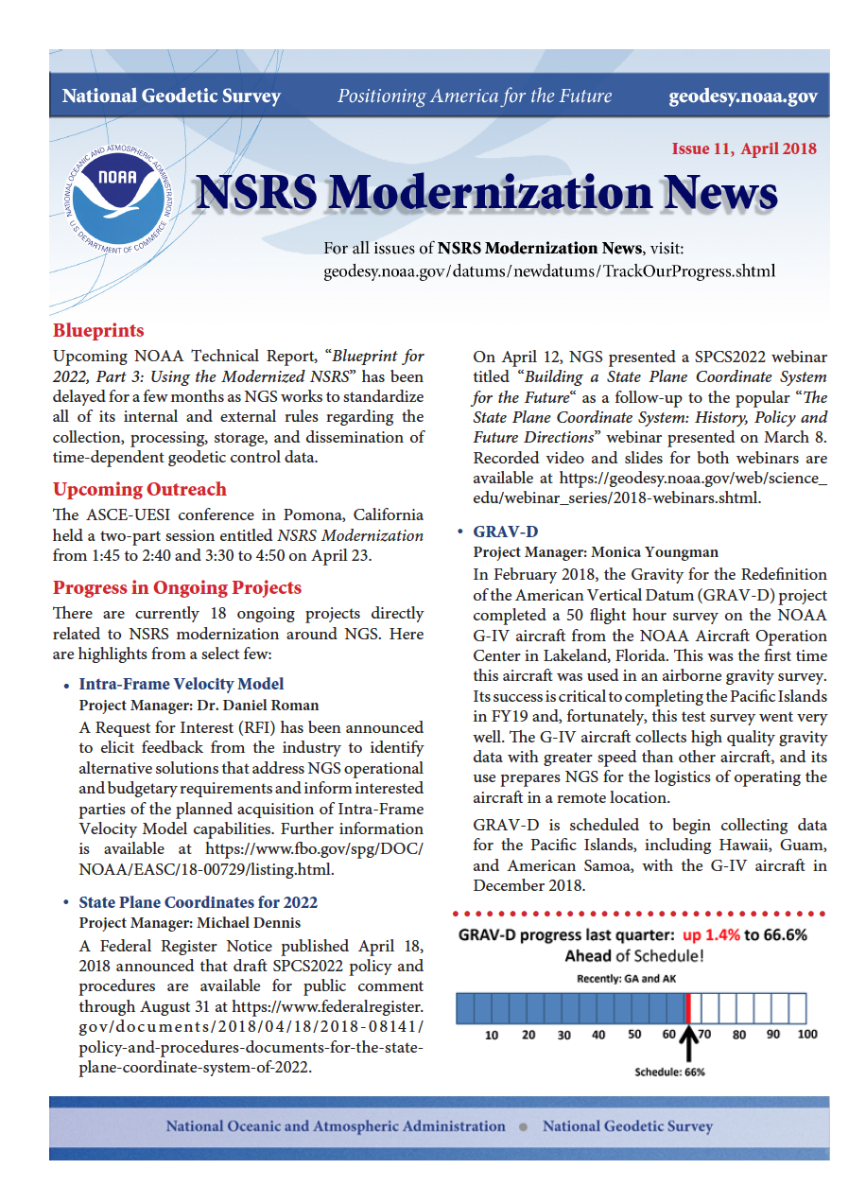
- NSRS -
Track
Progress
Sign up
Here
Notes:
Sign up? Get a news letter…. @
https://www.ngs.noaa.gov/

Slide 51
https://www.ngs.noaa.gov/ADVISORS/
-use any major search engine: “NGS advisors”
Daniel Determan
Northwest Regional Geodetic Advisor
dan.determan@noaa.gov
206-526-6874 (o)
202-306-6716 (m)

Slide 52
Example of application of EPP and IFVM
It’s 2039 and you are working in San Diego using NATRF2022
And you need to compare your work to another survey from 2028
Important: This slide only covers geometric coordinates.
…the catch is, that survey was done in PATRF2022
PATRF2022
ep. 2028.048
EPP2022
(PA)
ITRF2014
ep. 2028.048
EPP2022
(NA)
NATRF2022
ep. 2028.048
IFVM2022
(PA)
IFVM2022
(NA)
PATRF2022
ep. 2039.704
EPP2022
(PA)
ITRF2014
ep. 2039.704
EPP2022
(NA)
NATRF2022
ep. 2039.704

Slide 53
Example of application of IFVM
It’s 2039 and you are working in Chicago using NATRF2022
And you need to compare your work to another survey from 2028
Important: This slide only covers geometric coordinates.
NATRF2022
ep. 2028.048
IFVM2022
(NA)
NATRF2022
ep. 2039.704

Slide 54
Notes:
Picture: Map reflects the type of height improvements users could expect if NAVD 88 were replaced with a geoid-based vertical datum. (This is only a large scale approximation and should not be used as an absolute guide. Each benchmark might have its own level of mismatch, for example from uplift or subsidence, not captured by this broad brush. Also, this is the difference between the zero level of NAVD 88 and the actual geoid. The difference between NAD 83 ellipsoid heights and ITRF/GRS-80 ellipsoid heights has NO influence on this graph and should not be part of the story.)

